Slide 1
Assessing a written statistics assignment using a rubric
Anthony Morphett¹, Vasileios Giagos², Sharon Gunn¹, Jackie Reid³
¹The University of Melbourne, ²Manchester Metropolitan University, ³University of New England
FYIMaths workshop
28 June 2018

Slide 2
Formative assessment
Needs to:
Provide useful feedback to students
Contribute a mark to the final grade
Notes:
Feedback: where am I, where am I going, how do I get there? [Hattie & Timperley]
Final grade: should be valid, reliable

Slide 3
Maths and stats assessment
Traditionally:
Marking schemes
Feedback in form of overall mark + written comments
Assessment criteria and expectations not made explicit beforehand
Often ad-hoc, favouring procedural over higher-order skills
Notes:
Not that it has to be ad-hoc and favouring procedural skills, but often is, because no need to make criteria explicit -> doesn’t force you to reflect on criteria

Slide 4
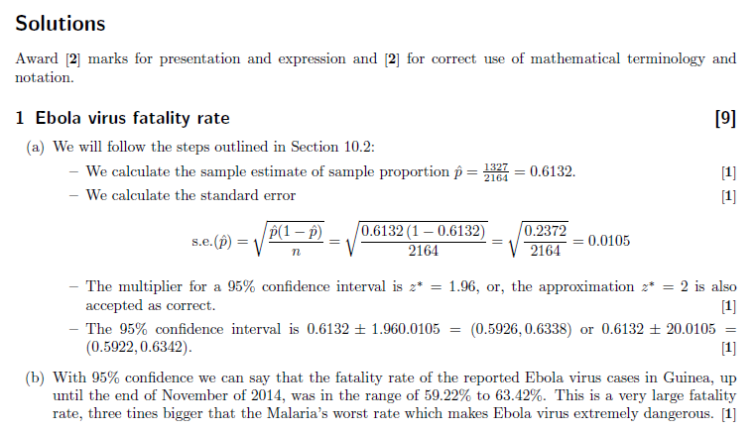

Slide 5
Rubrics
Criteria and descriptors explicitly given in advance
Student work assessed against each criterion
Feedback: grade for each criterion + overall mark + written comments
Transparency in assessment criteria beneficial for learning
Improved reliability and validity?
Notes:
These claims from general education literature. Research conducted in various fields eg humanities, management, health science, education. Hard to find solid research on rubric use in statistics (rather than recommendations or sample resources). Also ‘improved’ compared to what? How does it compare to the status-quo in maths & stats?
Why aren’t rubrics used more widely?
Harder to implement compared to traditional approach
Unclear whether findings from other disciplines will carry over to stats?
Concerns about reliability?

Slide 6
Question | Criterion | Level |  |  |  | Mark
 |  | Accomplished (HD) | Developing | Benchmark (PASS) | Fail
1(a) | Understanding of key concepts and techniques |  |  | 1 CI for prop | 0 incorrect | /1
 | Mathematical manipulations and computations | 2 Complete and correct |  | 1 Some minor errors | 0 | /2
1(b) | Interpretation and explanation of results | 1.5 Correctly interpreted a confidence interval as range of plausible values, in context; an evaluation/analysis of what it means, in terms of direction/difference in rates | 1 Correctly concludes a difference in rates and provides some explanation; some errors in interpretation of confidence interval | 0.5 Conclusion without explanation | 0 | /1.5

Slide 7
Mathsassess
Aim to improve assessment in maths & stats
Bank of resources for teaching staff to draw upon
Dimensions, criteria, descriptors
Trials of rubric-based assessment in maths, stats

Slide 8
Our project
Investigate relevance of mathsassess resources for a written introductory statistics assignment
Compare rubric-based and traditional approach with respect to
Communicating expectations & feedback
Consistency of grading
Ease of use

Slide 9
Context
Introductory stats subject at regional university
Summer trimester, taught online
166 students, mostly sciences
1 lecturer, 6 tutors
4 written assignments, 10% each
Notes:
“Statistical Modelling for the Sciences”
Lectures & tutorials online
Uses R

Slide 10
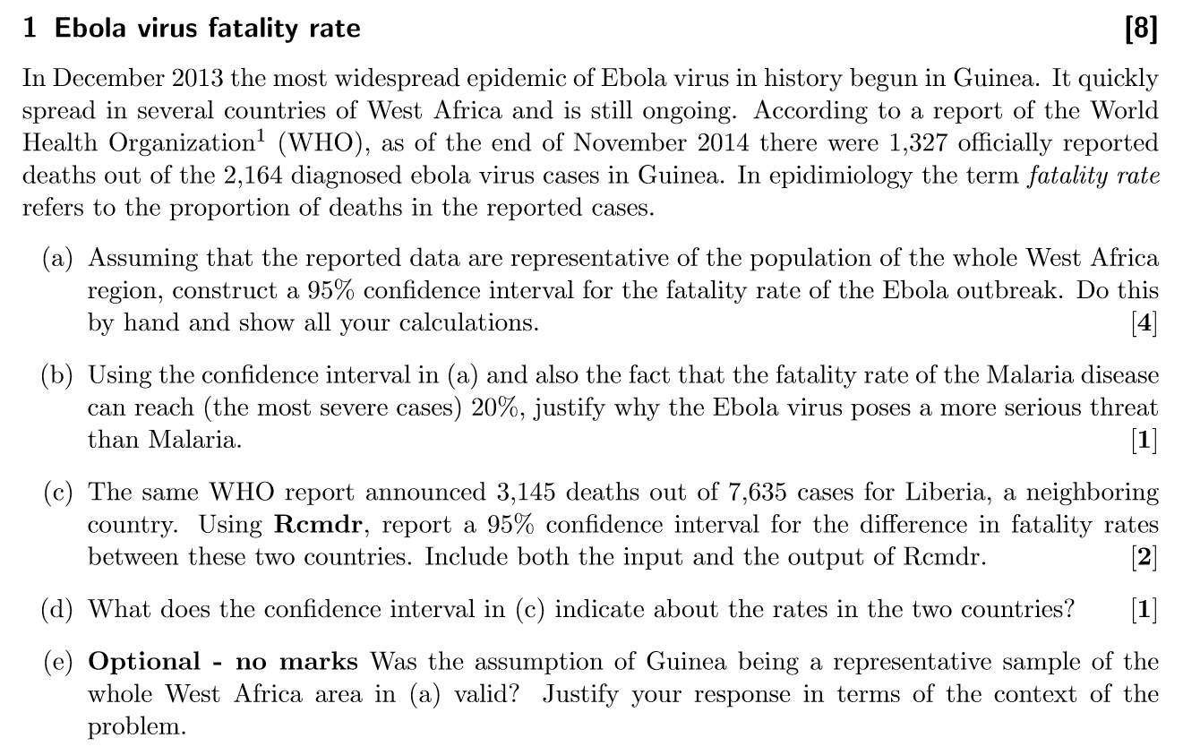
Assignment 3

Slide 11
Rubric development
Lecturer wrote assignment questions & solutions
We first developed a ‘mapping template’:
mathsassess criteria relevant to each question
Subject ILOs being assessed
Levels of SRTL, SOLO, Bloom
Then constructed the rubric:
mathsassess criteria
Task-specific descriptors
Tutor workshop
Notes:
Mapping template helped in rubric design but also helped us align assessment with ILOs and SRTL. For instance, if we had identified ‘statistical reasoning’, then we made sure that the descriptors included interpretation of results in context.

Slide 12
Consistency of marking
Random sample of 20 assignments
Marked by 5 tutors using both approaches
Bayesian analysis
Notes:
First using marking scheme, two months later using rubric

Slide 13
Consistency of marking - results
One marker systematically giving lower marks in both approaches
One marker became more consistent with others, one less
Similar variance in marks for both methods
No evidence to suggest a difference between approaches
Agrees with other research: mathsassess, Jonsson & Svingby (2007)
Notes:
Jonsson & Svingby (2007): many studies in their research review obtained levels of reliability that would be considered low by traditional psychometric requirements, but are nevertheless acceptable for the purposes of formative assessment.

Slide 14
Expectations and feedback
Student survey [16 responses, 10%]
Interviews with markers

Slide 15
Expectations - results
Student perceptions mixed
Markers felt rubric had helped some students
Literature suggests better results if accompanied by meta-cognitive activities
Notes:
Some recognise rubric as useful only in retrospect, others felt rubric was too ‘vague’ and suggested more specifics were needed for it to be useful (wanting to be told what to do?)

Slide 16
Feedback - results
Student perceptions mixed
Markers still provided extensive written comments
-> rubric an additional form of feedback, not a replacement

Slide 17
Ease of use
Considerable work to implement the first time
But leads to reflection on assessment and improved alignment
mathsassess a good starting point!
Tutors happy to use rubric

Slide 18
mathsassess
mathsassess suitable for intro stats assignment
Used criteria from all dimensions except ‘Proof’
Needed only one additional criterion:
Interpretation of graphical representations

Slide 19
mathsassess vs SRTL, SOLO, Bloom
SOLO, Bloom, SRTL based on cognitive activity etc
→ not directly observable
mathsassess criteria are task-oriented
→ address aspects directly observable in student work
→ straightforward to apply to a new task
Our approach: mathsassess for criteria, SRTL in descriptors
Notes:
Directly observable: mathematical manipulations and computations and defining variables

Slide 20
In conclusion
mathsassess suitable for intro stats assignment
Rubric marking similar consistency to traditional approach
Potential for better communication of expectations, feedback but doesn’t happen automatically
Good for reflecting on and improving assessment practices

