Slide 1
Moodle Quizzes: Beyond Multiple Choice
Jo-ann Larkins
Scholarly Teaching Fellow (Statistics) Federation University
FYiMaths Workshop 6 June 2018

Slide 2
Principles of Assessment
Valid accurately measures what it is intended to measure
Fair gives all students and equal opportunity to demonstrate what they know
Reliable gives the same, consistent result regardless of when or where the assessment occurs or who does the marking
Manageable is appropriate in size and cognitive load for the students being assessed

Slide 3
Practicalities / Realities of Assessment
Feedback should be timely and useful for student’s learning (also they need to access it!)
Students should be presented with authentic, contextualised scenarios (both from an engagement and skills building point of view)
Economic realities / academic time / decreased marking support – marking processes should be efficient (and increasingly online / digital)

Slide 4
This is not a “How to do Moodle” presentation?
There are a variety of LMS (Moodle is just one that is fairly widely used)
This is about thinking about using the tools (quiz tool in Moodle in this case) ‘outside the box’ to fit our assessment needs

Slide 5
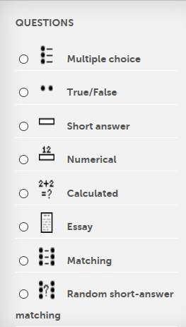
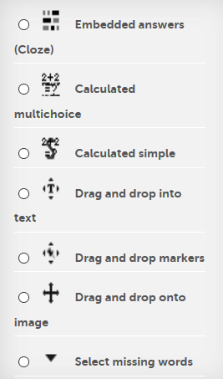
Moodle Quiz Question Types

Slide 6
Major question types I use
Multiple choice – Allows the selection of a single or multiple responses from a pre-defined list, can have partially correct answers – choices can be text, formulas or multimedia.
Embedded answers (cloze) - Very flexible, but can only be created by entering text containing special codes that create embedded multiple-choice, short answers and numerical questions.
Essay (previously paragraph) - Allows a response of a file upload and/or online text. This must then be graded manually.

Slide 7
Case study 1: Auto-marking of Excel work
Unit: First year Business Statistics
Software focus: Excel including Data Analysis package
Task: Executing a one sample t-test from first principles using Excel – i.e. calculating test statistic, finding critical values and p-values, making decisions about hypotheses and conclusions.
Quiz is used as a marking tool.

Slide 8
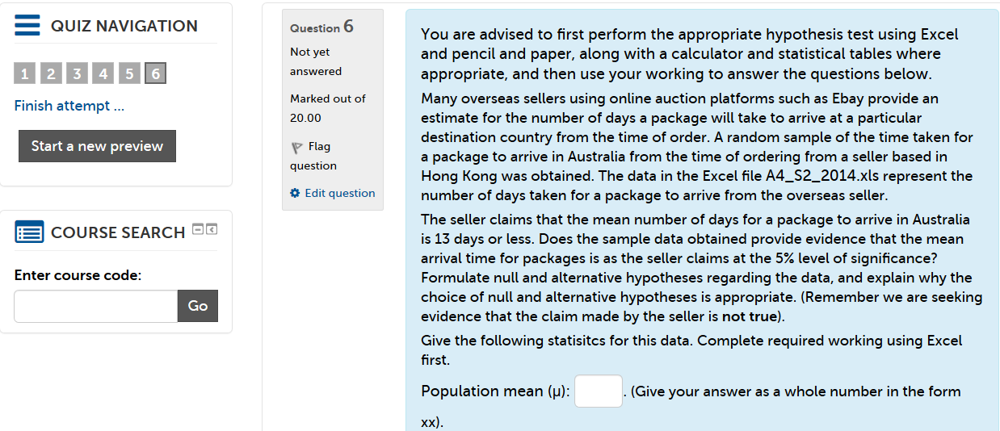

Slide 10
Case Study 2: Portfolio marking
Unit: First year Essential Mathematics for Science
Task: Students complete portfolios of assigned work in class. Every second portfolio, students enter their work in an online quiz designed to check their answers (and mark their work). They are allowed two attempts (reduces requests to teaching staff for odd data entry). After due date, have access to worked solutions.
Variety of questions types used…

Slide 11
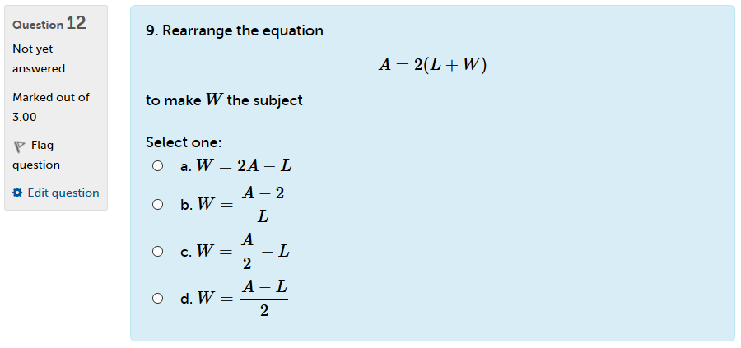

Slide 12
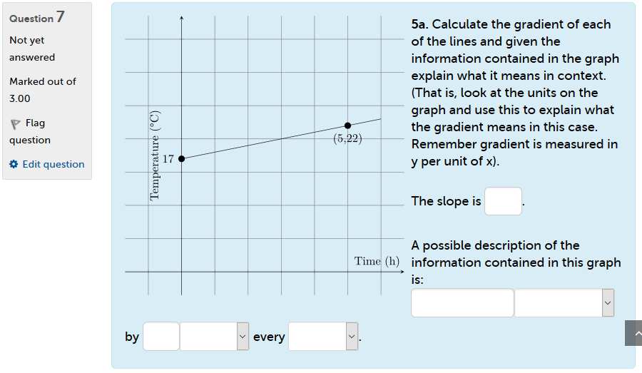

Slide 13
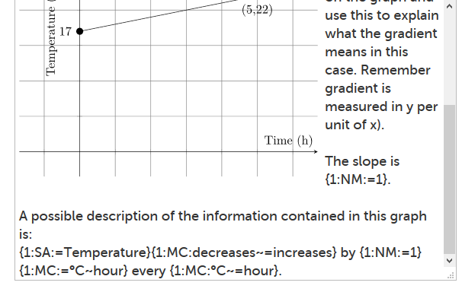

Slide 14
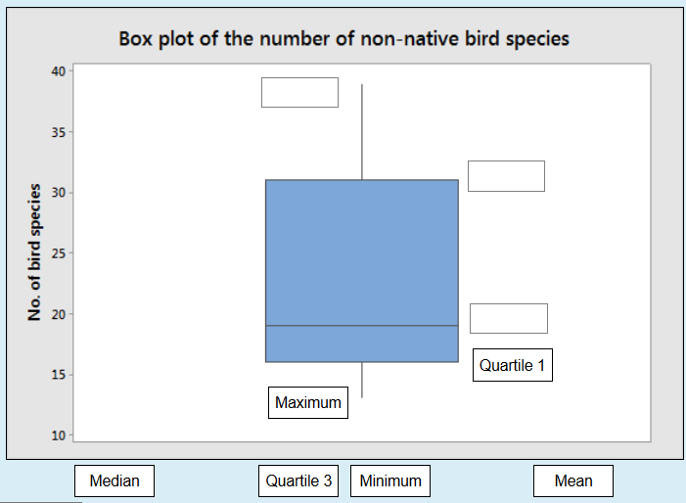

Slide 15
Case study 3: Learning Minitab (Computer lab marking)
Unit: Introductory Statistics (for everyone)
Software focus: Minitab
Task: Weekly computer lab classes designed to build skills in use of software for particular statistical tasks
Quiz is used as the basis of both the instruction and marking. (Includes some questions which are tutor marked after class – mix of conclusion paragraphs, graphs, Minitab output, explanations of concepts, formulas and symbols)

Slide 16
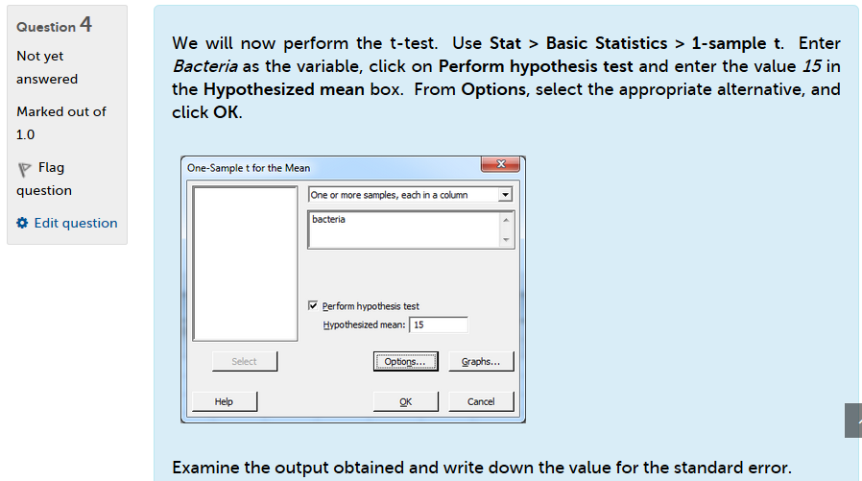

Slide 17
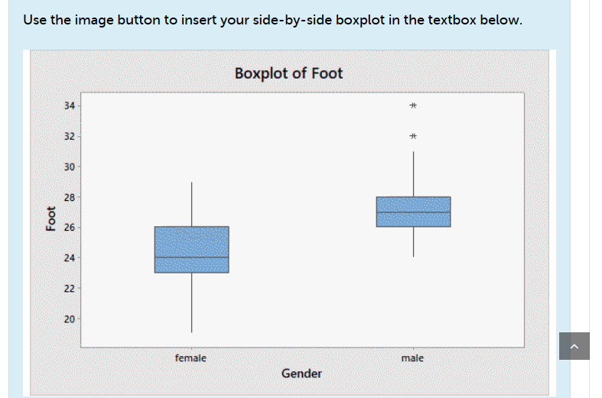

Slide 20
