Slide 1
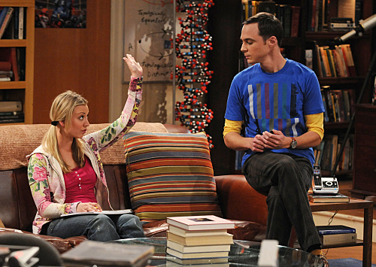
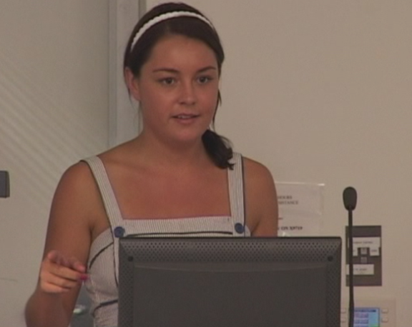
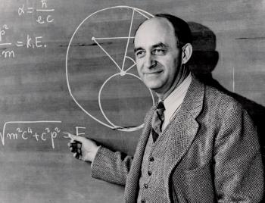
Fermi problems stimulate
knowledge integration
Les Kirkup
FYi Maths, UTS, February 2017
Notes:
Fermi problems as a ‘entree’ to full-on Problem Based Learning

Slide 2
[We will create] learning experiences that will
involve authentic and novel opportunities and problems that require inventive responses, raise questions of ethics and values, and drive students to integrate their developing knowledge, skills and values.

Slide 3
Real world and practical
The most interesting and stimulating styles of
teaching and learning were said to be student-led research, practical activities, and the study of real-world examples within the student’s sphere of experience.
Health of Australian Science
May 2012

Slide 4
Problem based learning (PBL)
Some characteristics of PBL
Involves unstructured problems/scenarios
Active learning is emphasised
Promotes collaborative problem solving
Uses, and builds on, prior learning
Students are self-directed
Requires integration of information from a variety of sources
No unique ‘right answer’ exists
Defense of methods and assumptions is required
Tutor plays a key role in supporting learning
Fermi problems
Yes
Yes
Yes
Yes
Yes
Yes
Yes
Yes
Yes
Notes:
Perhaps a good stepping stone to full PBL. Fermi problems are short and self contained, but there is no reason they couldn't be expanded to require students to go away, learn something (which could be some particular physics or mathematics so long as it is relevant to the problem), and bring it back to be considered by the group

Slide 5
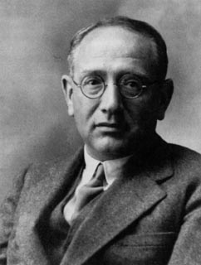
The problem should be..
‘well chosen, not too difficult and not too easy, natural and interesting’
Polya, G. (1945) How to solve it. Princeton: Princeton University Press
Notes:
‘The essence of a Fermi problem is that a well-informed person can solve it (approximately) by a series of estimates.’
Ross and Ross (1986) Fermi problems or how to make the most of what you already know. Estimation and mental computation Shoen and Zweng (Eds). Reston VA: National Council of Teachers of Mathematics

Slide 6
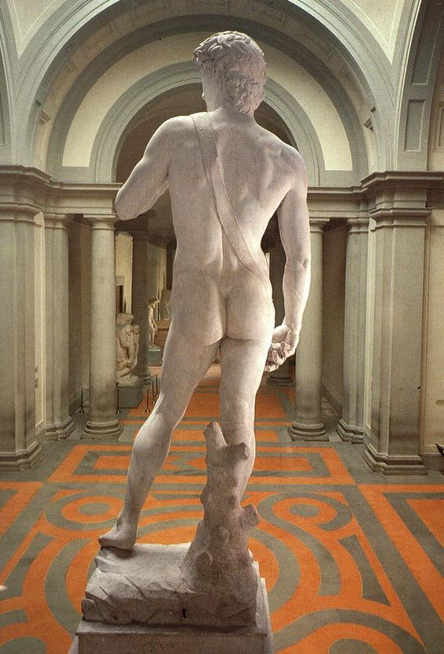
Example
Here is a Fermi problem for you to work on (please work individually on this one):
Estimate the volume of your whole body.
Use your answer to 1) to estimate the size of the upward force on your body due to the air it displaces.
Notes:
Part i) can be attempted by anyone, but part 2) requires some physics knowledge (Archimedes principle), so this problem would be best done some time after the principle has been introduced to students (say through a lecture or online learning module).

Slide 7
Problem solving pro forma
What are you trying to estimate?
What physical principles are you going to apply, and/or what information do you need?
What values or equations do you already know that will help you solve the problem?
What assumptions have you made (be prepared to defend these)?
What have you guessed or estimated? (Categorise your confidence in the guesses/estimates as poor, moderate or high – and be prepared to defend these)
Now work through the calculations (and write them down)
What is your answer?
Compare your answer with a group nearby working on the same problem – how closely do the answers agree?

Slide 8
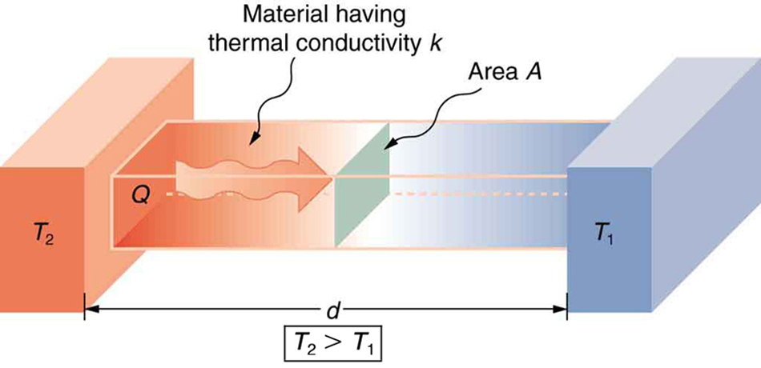
Thermal conduction
Rate of heat flow
$$\frac{Q}{t}=\frac{kA}{d}\left(T_{2}−T_{1}\right)$$
Notes:
A first course on heat and temperature would consider heat flow mechanisms. So (ideally) prior to the problem solving session, heat flow due to conduction would have been studied by the students (though they would not be pointed directly to this equation during the problem solving session).

Slide 9
Fermi Problem
Les has built a small wooden cabin in his back garden in Sydney to act as an office. The cabin has floor dimensions of 3m × 4m. On one winter’s day, Les maintains the inside temperature at 23 °C while the outside temperature is at 14 °C.
Estimate the amount of heat lost from the cabin over 12 hours
How much will it cost to heat the cabin for 12 hours using electricity?

Slide 10
On reflection….
How would your students react to this type of activity?
What skills would students gain through this activity (in addition to those they would gain from solving ‘standard’ or ‘textbook-type’ problems)?
How would these skills benefit graduates in the workplace?

Slide 11
On reflection….
In what ways might you prepare students for this activity?
What challenges would you/your tutors face in supporting students doing this activity?

Slide 12
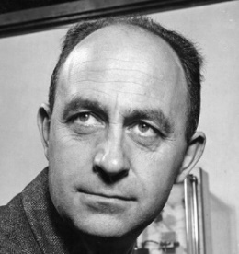
Fermi Problems:
are more engaging if situated within contexts students can relate to, and with clear links to their major area of study
need scaffolding, (but the challenge should grow as a student’s self-confidence grows)
should require students to integrate disciplinary knowledge with what they know already or are currently learning.
should require students to: collaborate; defend their methods and assumptions, and; communicate these to others

Slide 13
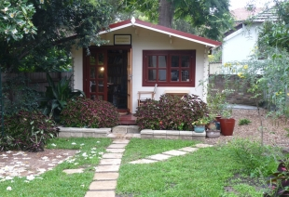
Thank you

Slide 14
Exam question (Autumn 2015)
This is a Fermi Problem type question for which there is no single ‘correct answer’. We are much more interested in your methods than the numerical answer you arrive at.
Research done in the School of Mathematics and Physical Sciences at UTS by Professor Geoff Smith and Dr Angus Gentle has shown that radiative cooling that occurs overnight can remove 45 W/m² from water stored in a container.
Estimate the volume of water that can be cooled by 5 °C overnight by radiative cooling panels attached to a house roof.
To assist you to answer this question please consider:
What physical principles are you going to apply, and/or what information do you need? (2 marks)
What values or equations do you already know that will help you solve the problem? (2 marks)
What assumptions have you made? (2 marks)
What have you guessed or estimated? (Categorise your confidence in the guesses/estimates as poor, moderate or high) (2 marks)
Show your calculations (2 marks)
What is your answer? (1 mark)

Slide 15
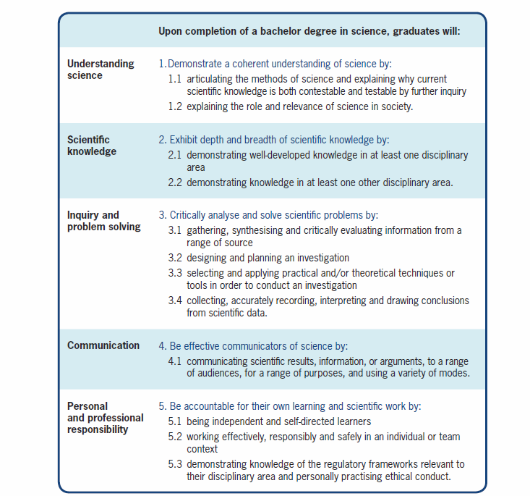
Science Threshold Learning Outcomes

