Slide 1
What is in the curriculum: teacher and lecturer perspectives on high school students’ understanding of the limit definition of the derivative
Michael Jennings FYiM 2019

Slide 2
Question 4. The definition of the derivative (or the derivative from first principles) is given by the following:
$\lim_{h→0}{\frac{f\left(x+h\right)−f(x)}{h}}$ or $\lim_{b→a}{\frac{f\left(b\right)−f(a)}{b−a}} .$
(a) What does this definition mean?
(b) Use this definition to determine $f′(x)$, where $f\left(x\right)=x^{2}.$

Slide 3
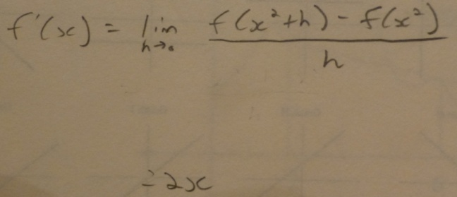
Student responses

Slide 5
Teacher v Lecturer perspectives
There was a statistically significant difference (p<0.01) between the teachers’ and lecturers’ perspectives.

Slide 6
(T) They would possibly not have been asked to reproduce such a response before and the syllabus does not explicitly require students to explain the meaning of the derivative from first principles, merely to use it.
(T) First Principals (sic) knowledge. Since a greater understanding of Limits is no longer in either syllabus they will only have a superficial understanding of this specific meaning.

Slide 7
interpretation of instantaneous rate of change at a point as the gradient of a tangent and as the derivative at that point (QCAA, 2014).
The rates of change component of the previous syllabus, published in 1992, is nearly identical to the 2008 syllabus that the teachers were using at the time of this study. In fact, an extra 10 hours is allocated to the rates of change component of the 2008 syllabus in comparison to the 1992 syllabus.

Slide 8
(T) This is a great question. I feel few students in QLD would be able to answer this question well. I have streamed classes with top maths students, I would be disappointed if most couldn't provide an adequate answer.
(T) Even though it's been carefully explained when calculus is first introduced, students tend to "move on" from anything like proof or in this case a fundamental concept explanation, unless we have repeatedly emphasised it. Sad. Many schools and teachers don't value the fundamental concepts - they just want action, so you don't see many questions of this type any more.

Slide 9
(L) I would normally not expect a high school student to give a reasonable response to this question because too many high school math teachers couldn't either.

Slide 10
(b) Use this definition to determine $f′(x)$, where $f\left(x\right)=x^{2}.$
There was again a statistically significant difference (p<0.001) between the perspectives of teachers and lecturers.

Slide 11
(T) I anticipate my students at term 1 will only remember the short cuts not how to apply the limit but this is something most of them could attempt.
(L) If they have *just* been shown how to do it properly, they will be fine and will refer to examples. Two or three weeks later, they won't have a clue. It will be entirely forgotten by the time they get to university.

Slide 12
6 months later… same question asked
(T) First principles – YUCK - Why would we need this when there is a quicker way to do it.
(T) Its (sic) stupid to do it that way, it takes too long. By the rule is much easier.
(L) AM should give students an added advantage in tackling the problem. Presumably they would have had more exposure & practice to problems of this sort.

Slide 13
(T) Very few bother to understand the concept and hence only a few would be able to reproduce the required working in Year 12. Without the restriction of using the definition, nearly all Year 12 IM students would find the derivative correctly.
The notation of limits is rarely used through the Year 11 and 12 courses; therefore it is likely that many of our students wouldn't be comfortable with it. The focus in our course is applied mathematics not pure.
(L) If they had at least grade of B in AM, I would assume their response would be a bit better, but I still doubt that limit rules are taught properly at most schools. The reason for a better reply would in my honest opinion mainly be a self-selection effect with respect to the type of students who choose AM.

Slide 14
So what?
1. Why were the teachers so divided in their opinions of whether students could successfully find a derivative from first principles?
2. What are the implications of teachers and lecturers holding different perceptions on students’ calculus skills and understanding?
3. What is important for the curriculum and who decides?

Slide 15
Thank you
Michael Jennings | Lecturer
School of Mathematics & Physics
msj@uq.edu.au
07 3365 3255
facebook.com/uniofqld
Instagram.com/uniofqld

