Slide 1
Reflections of an incoming ADLT – FYi Maths at JCU
Shaun Belward
College of Science and Engineering

Slide 2
Dean’s instructions to incoming ADLT
Brisbane
Singapore
Student experience

Slide 3
Dean’s instructions to incoming ADLT
Grow our pie
Look after our existing students

Slide 5
Level 1 Maths @ JCU
MA1022 | MA1020 | MA1000 | MA1003 | MA1580
Essential maths | Preparatory maths | Maths foundations | Math techniques | Intro to data science
Diploma | Maths B replacement | Maths B prerequisite | MA1000 prerequisite | Maths B prerequisite
Diploma of Higher Ed | Science (if no Maths B) Geology Sport Science Information Tech | Engineering Marine Science Advanced Science Education (Secondary Maths) | Engineering Advanced Science Education (Secondary Maths) | Core in data science major
Year 10 maths | Year 12 – up to diff calculus | Review of Maths B & some Maths C | Integration, DEs, parametric eqs, sequences, series | dealing w data: pre-processing, R, algorithms, interpret

Slide 7
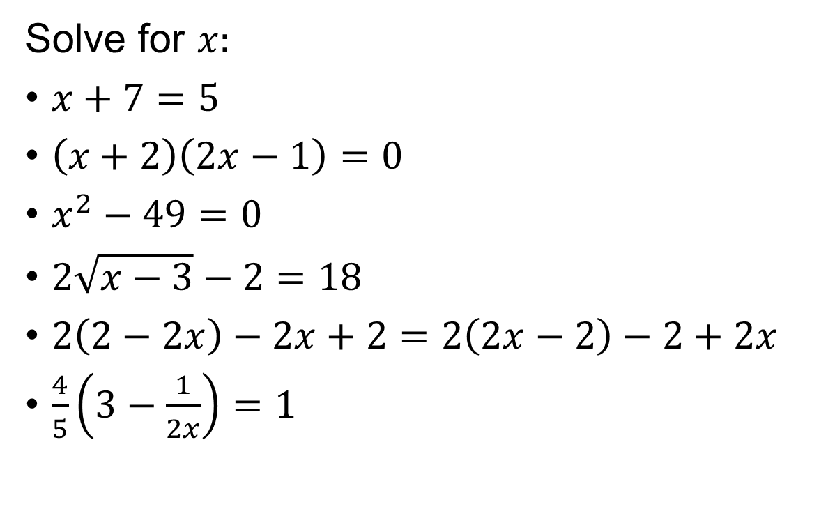
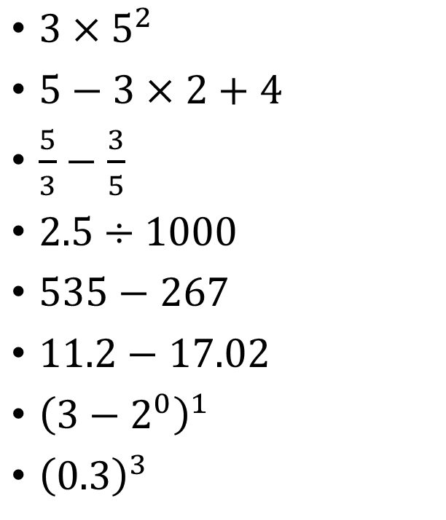
MA1000: Diagnostic test – 20 questions, 90% accuracy
$3×5^{2}$
$5−3×2+4$
$\frac{5}{3}−\frac{3}{5}$
$2.5÷1000$
$535−267$
$11.2−17.02$
${\left(3−2^{0}\right)}^{1}$
${\left(0.3\right)}^{3}$
Solve for $x:$
$x+7=5$
$\left(x+2\right)\left(2x−1\right)=0$
$x^{2}−49=0$
$2\sqrt{x−3}−2=18$
$2\left(2−2x\right)−2x+2=2\left(2x−2\right)−2+2x$
$\frac{4}{5}\left(3−\frac{1}{2x}\right)=1$

Slide 8
Learning in MA1000
Lectures (largely traditional format, but with opportunity to discuss)
Tutorials (tutor led activity, plus opportunity for questions)
Workshops (use of technology in learning)
Study groups (encouraged, not enforced)

Slide 9
Learning in MA1000

Slide 10
Learning in MA1000

Slide 11
Learning in MA1000

Slide 12
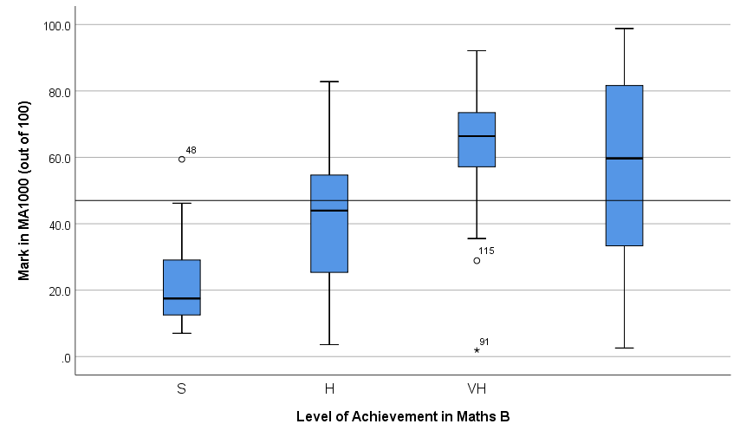
MA1000 marks distribution by Maths B grade

Slide 13
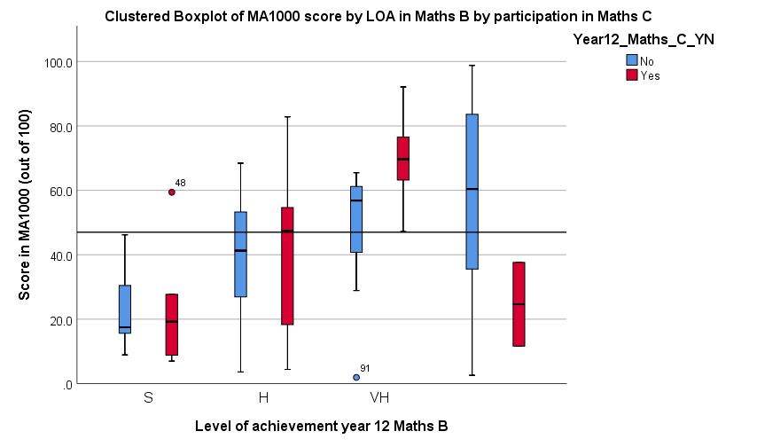
MA1000 – marks distribution with Maths C

Slide 14
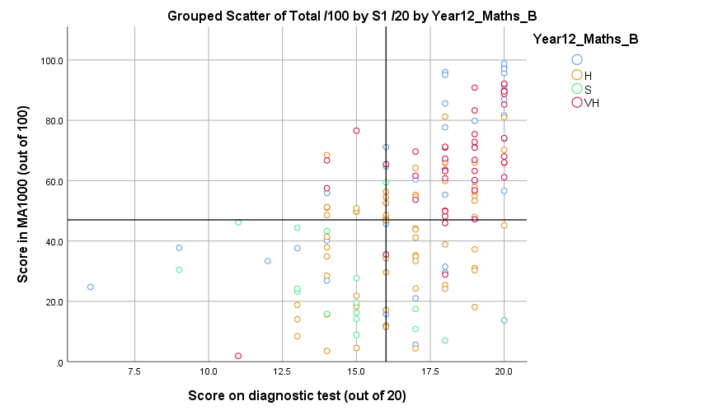
MA1000 – effectiveness of diagnostic testing

Slide 15
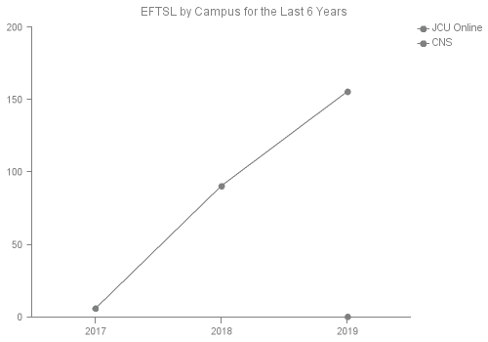
New markets – fully online Master of Data Science

Slide 16
New senior curriculum
Content area | Time allocation Maths B (hrs & %) | Time allocation Maths Methods (hrs & %)
Introduction to functions | 35 (16.3%) | 26 (11.8%)
Rates of change | 35 (16.3%) | 31 (14.1%)
Periodic functions | 30 (14%) | 28.5 (13%)
Exponentials and logs | 35 (16.3%) | 48.5 (22%)
Introduction to integration | 25 (11.6%) | 18 (8.2%)
Applied Statistical analysis | 25 (11.6%) | 59 (26.8%)
Optimisation | 30 (14%) | 9 (4.1%)
Total | 215 | 220

