Slide 1
Beyond Rote: Enquiry-Oriented Learning through Problem-Based Workshops
Stephen Woodcock

Slide 2
Bridging the gap: High School to the workplace
Many high school students prioritise rote learning and exam “training” techniques.
By focussing only on the mechanics, but not deeper understanding, mathematics can be seen as dry/disconnected/demotivating.
Often students lack the confidence (but not ability) to approach unseen problems.
Assessments often seen as arbitrary barriers to be strategically evaded.

Slide 3
Enquiry-oriented learning
Understand that in industry or research, problems do not arise already formulated in a previously-seen form.
Make reasoned and justified simplifications, approximations and assumptions to allow scenarios to be modelled by mathematical or statistical techniques.
Be able to communicate these to peers/colleagues/clients.
Reflect on initial beliefs and methods, both as an error-check and for refining future practice.
Inspiring students through exposure to “problem-based, issues-based or practice case-based approaches to learning in subjects”.

Slide 4
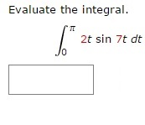
Why online resources?
Wide range of backgrounds from HSC (or equivalent.)
Students can attempt as many or as few problems as they need and receive instant feedback.
Randomised question generation for each student.

Slide 5
Why online resources?
Why not only online resources?
Can, however, reinforce mentality of exam “training” and rote learning.
Still only gives students experience responding to already-formulated problems.
Given , students can often find
Most problems are largely removed from their initial motivation or application.

Slide 6
New mathematical science curriculum
Centred around core first year subjects which blend online resources with more practical modelling workshops.
Online assessment strengthens the commitment to developing disciplinary knowledge.
Modelling workshops develop a wider perspective and motivation.
In workshops, students able to work in groups to discuss different perspectives, estimates and ideas.
Low-weight assessment on problem-based workshop, but compulsory participation requirement (cannot pass subject with fewer than 7 of 10 adequately completed.)

Slide 7
Advantages of workshop structure
Low stakes assessment while confidence with these newer skills is developed. Marks are for contributions to group discussion, not on correct answers.
Act as “trailer” for research-inspired problems which will be studied and assessed in greater detail in later subjects.
Groupwork tasks from the first week of first year help to familiarise students with their peers, delivering on commitment to aiding transition to university.

Slide 8
Typical Workshop template
Real world problem and motivation
Estimates & assumptions. Why?
Simplified related problem – more intuitive
Reflection on results and initial estimates. Lessons learnt for future problem solving.
Students bring together prior skills and new perspectives to tackle initial problem
Students see how their knowledge and skills can be applied
Completely “open book”, mirroring practice in industry, consulting and research.

Slide 9
37131: Introduction to Linear Dynamical Systems
Workshop 7

Slide 10
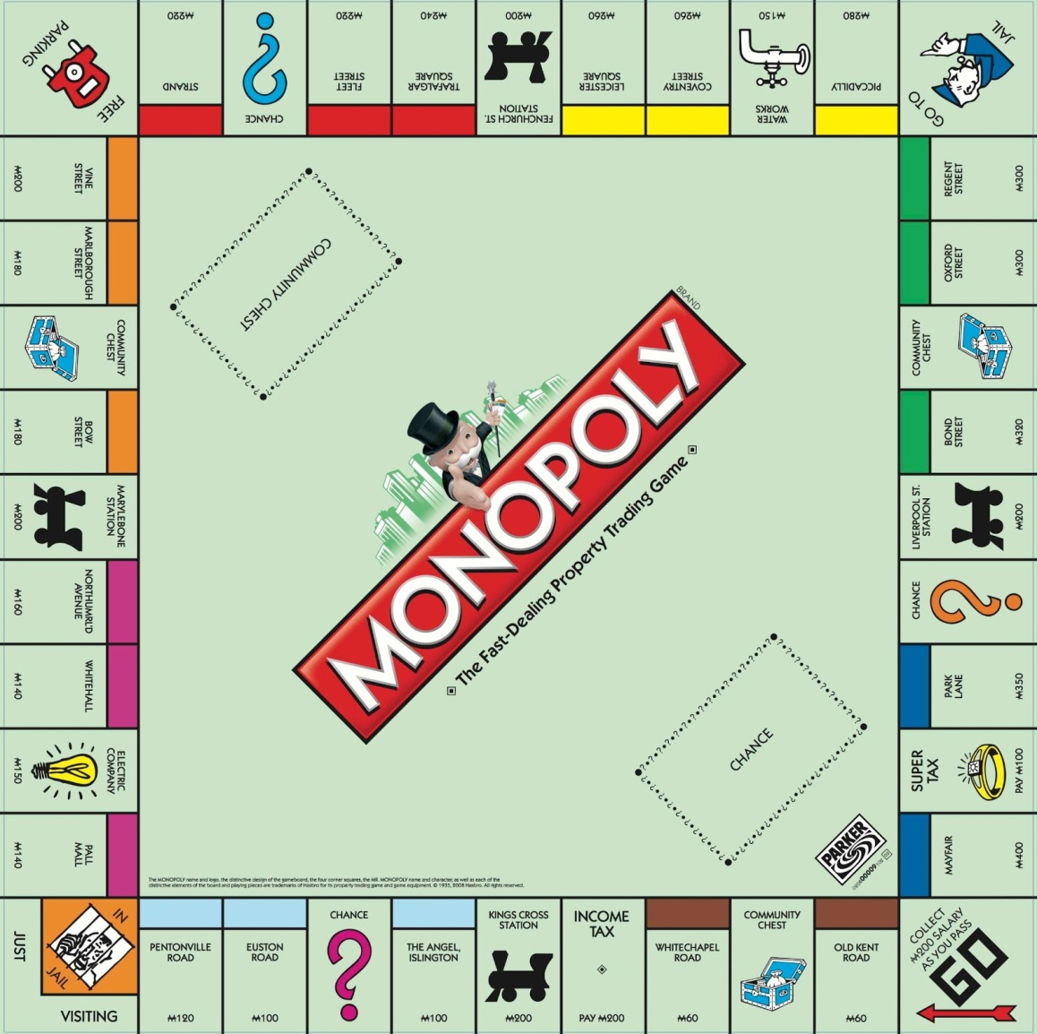
Task one: monopoly
The board game Monopoly consists of 40 squares. Players roll two dice and move round the board.
If a player lands on a square which has not been bought yet, he/she can purchase it. If a player lands on a square which has been bought by an opponent, he/she must pay rent to that player.
Which squares are best to own? Why?

Slide 11
Random walks on graphs
A B
C D
The sequence of squares on which a player lands forms a random walk.
We can draw a directed graph showing all positions, linked by arrows showing all possible moves between positions.
The graph for a Monopoly board would be extremely difficult to draw – it would contain 40 different states (one for each square) plus arrows joining each square to all possible squares that a player could move to from it.
The graph above show that a player in A can only move to B. A player in B can move to D or C. A player in C can move to A or B and a player in D can only move to B.

Slide 12
Task two: estimation
Very quickly, look at the simple directed graph shown here and estimate what proportion of the time you would expect the walker to be in position A and what proportion of the time you would expect the walker to be in position B.
A B

Slide 13
Random walk
This was really a trick question.
You need a lot more information to be able to answer this:
Are the moves A to B and B to A equally likely? For example, assuming someone buys one lottery ticket each week and A is “I won the lottery last week” and B is “I didn’t win the lottery last week”, moving A to B is about 8 million times as likely as B to A.
Any initial conditions? Did you start in A or B?
How long has the random walk been running? Eventually initial conditions will likely be less relevant. For example, predicting the temperature knowing the temperature one minute ago vs predicting the temperature knowing the temperature several hundred years ago.
A B

Slide 14
Task three: expected positions
For each of the following examples, assume that all possible moves from a position are equally likely. For example, if there are 4 possible positions to move to from your current position, assume that each of these happens 1/4 of the time.
If each random walk is left for a very long time (moves ) what proportion of the time to you expect to find the walker in each state?
A B
C D
E F
G H
I J
K L
M

Slide 15
Expected positions
The random walks associated with first two graphs are relatively easy to analyse.
As all moves are equally likely, the ABCD graph is completely symmetric, hence all positions are equally likely.
For the EFGH graph, state G is absorbing i.e. cannot be left. Eventually, the walker will
certainly
be in G.
The IJKLM graph is harder to analyse.
A B
C D
E F
G H
I J
K L
M

Slide 16
Transition matrices
A transition matrix contains the probabilities of, in a given move, moving from each state to each other.
The entry in row i and column j is equal to the probability of
moving from position i to position j in a given move.
For example, the transition matrix for the ABCD graph is
A B
C D

Slide 17
transitions
We can use the transition matrix to work out where the walker is likely to be in future,
For example, if I know that the walker is in A at a given time, I can represent this by a vector with a 1 for position A and a 0 for all others .
If I want to know where the walker might be one move into the future I simply calculate
Half of the time the walker will move to B and half of the time to C.
A B
C D

Slide 18
Steady states
If we repeat this a large number of times, we will get to the proportions of time that we would expect to find the walker in each position if left for a long time.
In general, let the proportions after n moves be . These then give
If the system reaches a stable distribution of proportions, then .
Let the transition matrix be T, then we are solving .

Slide 19
Steady states
hence for appropriate identity matrix , we have .
Since we cannot simply have , this tells us that our solution must come via being singular.
If we transpose , we get where .
In other words, we find by finding an eigenvector of corresponding to the eigenvalue 1 (since our characteristic equation gives is singular, not the more general is singular, hence we know .)

Slide 20
example
For the ABCD graph, we transpose the transition matrix and find an eigenvector corresponding to the eigenvalue 1.
We solve
Letting gives
This solves to give since . (Why?)
A B
C D

Slide 21
Task four: eigenvectors
E F
G H
I J
K L
Write down the transition matrix T for graphs EFGH and EIKLM.
For each graph, find the eigenvector of corresponding to the eigenvalue 1 and hence find the long-term proportion of time that the walker spends in each position.
M
Hint: You should already know the result for the EFGH graph. The IJKLM graph is less obvious.

Slide 22
Steady states
For EFGH, we have T = hence we solve
to find .
Similarly, for IJKLM, we have T = and

Slide 23
ANSWERS TO MONOPOLY question
Someone has actually calculated the transition matrix, including all possible rolls of the dice (2 to 12 for rolling two dice) and all possible Chance and Community Chest random cards (e.g. “Advance to Go”).
41 by 41 matrix (40 squares, but can be “In Jail” or “Visiting Jail”).
There are two different transition matrices, depending on if a player wishes to leave jail as soon as possible, or is happy to remain on that square for the maximum three turns.
The resulting probabilities can be found at http://www.tkcs-collins.com/truman/monopoly/monopoly.shtml

Slide 24
ANSWERS TO MONOPOLY question
Expected proportion of time on each square, assuming the player leaves jail as soon as possible.
Orange squares (only just…) more likely to be landed on than any other colour.

Slide 25
Workshops for 37131 in 2015
Mortgage calculator and compound interest
Telecommunications satellites
Data science and regression models
Combinatorics (and how many ways to navigate Melbourne CBD’s grid system)
Projectiles, kinetics and sports science
Cryptography and data security
Graph theory (and how to win at Monopoly)
Game theory (in economics and ecology)
Data science and statistical estimation
Population and conservation biology
All centred on mathematics which students will likely have seen and used before, but in new, applied contexts.

Slide 26
So what did students think of this structure?
Generally very positive (Student Feedback Survey scores around 4.2 / 5):
However…
In conclusion:
“You can please some of the people all of the time, you can please all of the people some of the time, but you can’t please all of the people all of the time.” – John Lydgate
(1370 – 1451)

